Slide 1
Patient Problems

Slide 2
Patient #1 Natalie Smith
32 years of age. Recently had a minor road traffic accident. It was found that the accident was due to a loss of vision from 20/20 vision to a reduction of 12% in right eye and 10% in left eye. From 29 years of age patient has put on a lot of weight, even changing eating habits has not managed to shift any of the gained pounds. A disproportionate stature has been noticed. A diamond ring received as a present doesn’t fit anymore. Patient has been suffering from obstructive sleep apnoea (OSA). Chest pains and difficulty breathing. Large hands and pronounced jaw. Experiences frequent flushing - generalised increase in sweating, and has soft tissue swelling.

Slide 3
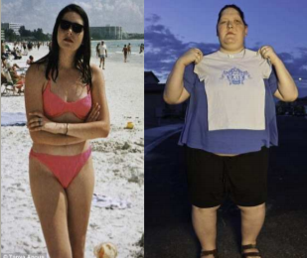
Patient #1 Natalie Smith

Slide 4
Patient #2 Sara Martin
25 years of age. She has signs for osteoporosis and easily bruised skin. She suffers from weakening muscles. She has recently been complaining about feeling low and having long onsets of bad moods – suggestive of depression. She has been suffering from hypertension and glucose intolerance, which may be due to her obesity. Her facial features look different as friends and family have noticed a particular change in weight. She seems to have put on weight dramatically especially around her neck.

Slide 5
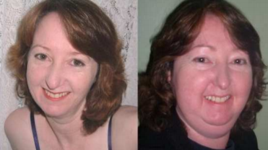
Patient #2 Sara Martin

Slide 6
Patient #3 Thomas Ulta
Thomas is a 35 year old male that has noticed that he has gained some weight, but does work in a candy factory where he samples the food. He feels very tired, has gained some weight, and noticed that his feet seem to tingle and his wounds heal very slow.

Slide 7
Patient #4 Kara Stomey
Kara is a 22 year old that has no energy, worries about everything, but is a first year med student. She has noticed that she has loose, frequent bowels and her best friend pointed out that her eyes look bigger.

Slide 8
Patient #5 Danielle Wilson
Danielle is she 43 years of age and noticed that she has gained lots of weight (at least 30 pounds!), but she quit smoking 3 months ago. She states that is not the reason for her visit today, but she feels that her neck has enlarged and she states that at times it is hard for her to breath, almost like she is being “choked”.

Slide 9
Patient #6 Cheryl Cassic
33 year old female, noticed that she has had some weight loss and a decreased appetite. She craves salt and is here today because she passed out two days ago, but just assumed that it was because she has been so tired lately. The nurse noted a low BP (blood pressure)

Slide 10
Your Job!
Today you each become a doctor. You have 6 patients on your books for the day, and it is your job to diagnose them. Remember you may not discuss your patient with anyone else, as this will violate doctor patient confidentiality. You must use the powerpoint format that is on my webpage to complete the patient charts. Good Luck!

